Slide 1


Green Pace
Security Policy Presentation
Developer: Noah Coleman

Slide 2

OVERVIEW: DEFENSE IN DEPTH
“Defense in depth is the practice of using multiple lines of defense to protect a given assets” (Training, 2017)

Slide 3
THREATS MATRIX
Likely STD-003-CPP STD-009-CPP STD-010-CPP | Priority STD-001-CPP STD-005-CPP STD-008-CPP
Low priority STD-002-CPP STD-006-CPP | Unlikely STD-004-CPP STD-007-CPP

Slide 4
10 PRINCIPLES
Validate Input Data
STD-001-CPP
STD-002-CPP
STD-008-CPP
Heed Compiler Warnings
STD-003-CPP
STD-005-CPP
Architect and Design for Security Policies
STD-004-CPP
STD-005-CPP
STD-008-CPP
STD-010-CPP
Default Deny
STD-007-CPP
Adhere to the principle of Least Privilege
Use Effective Quality Assurance Techniques
STD-004-CPP
STD-006-CPP
STD-009-CPp
Adopt a Secure Coding Standard
STD-002-CPP
STD-006-CPP
STD-009-CPP
Practice Defense in Depth
Keep it Simple
STD-001-CPP
STD-007-CPP
STD-010-CPP
Sanitize Data Sent to Other Systems

Slide 5
CODING STANDARDS
Rule | Severity | Likelihood | Remediation Cost | Priority | Level
STD-001-CPP | High | Likely | Low | P27 | L1
STD-005-CPP | High | Likely | Medium | P18 | L1
STD-008-CPP | High | Likely | High | P9 | L2
STD-010-CPP | Medium | Likely | Low | P18 | L1
STD-006-CPP | Low | Unlikely | High | P1 | L3
STD-004-CPP | Low | Probable | Medium | P$ | L3
STD-007-CPP | Low | Probable | Medium | P4 | L3
STD-002-CPP | Low | Unlikely | Medium | P2 | L3
STD-003-CPP | Low | Likely | Low | P9 | L2
STD-009-CPP | Low | Likely | Low | P9 | L2

Slide 6
ENCRYPTION POLICIES
Encryption in rest – encryption of static data
Protecting hard drives, data bases, and personal computers.
Encryption in flight - Encryption of transmitted data
Protecting data while it moves from point a to point b
Encryption in use – encryption of active data
Protecting data as it is written

Slide 7
TRIPLE-A POLICIES
Authentication
Authentication is the policy of identifying every user to access a system
Authorization
Authorization is the policy of only letting certain users access certain data
Accounting
Accounting is the policy of tracking everything a user does while in the system

Slide 8
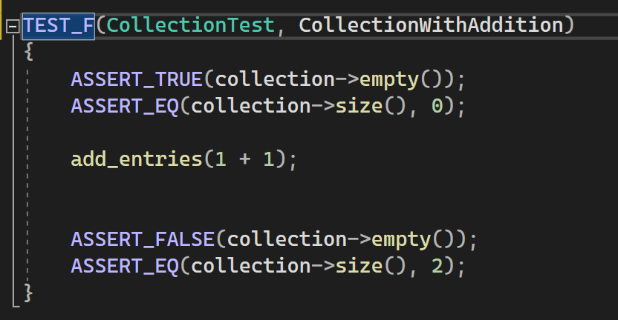
CollectionWithAddition

Slide 9
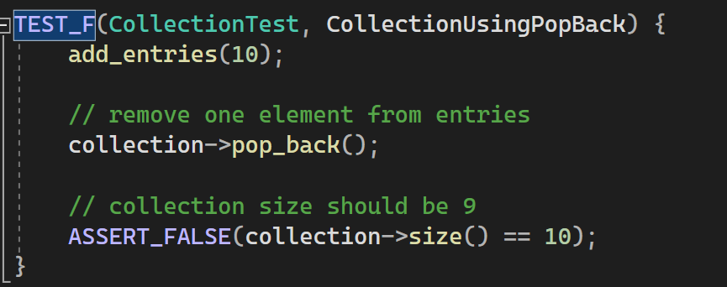
CollectionUsingPopBack

Slide 10

AUTOMATION SUMMARY

Slide 11
TOOLS
DevSecOps means having security at the center of development and operations
CPPCheck
Google Test

Slide 12
RISKS AND BENEFITS
Risk of Waiting – Opening the system up to threats
Data Breaches
Financial Penalties and Risks
Benefits of Acting – Security starts at Conception
Security as a foundation
Preventive Design

Slide 13
RECOMMENDATIONS
All security policies are vulnerable to becoming outdated and obsolete. Maintain a current policy updated regularly
Use Vulnerability checkers to keep up to date with new vulnerabilities discovered in common system architectures.
Teach every developer secure coding before they begin working on the system

Slide 14
CONCLUSIONS
Defense in depth should be the foundation of the security for the company. Every employees should have a security mindset, and security should be analyzed during each phase of every project.

Slide 15
REFERENCES
Dion Training. (2017). Cyber Security Minute: How does defense in depth work? YouTube. Retrieved March 12, 2023, from https://www.youtube.com/watch?v=lnIRqw0jutA.
Yendamury, G., & Mohankumar, N. (2021). Defense in Depth approach on AES Cryptographic Decryption core to Enhance Reliability. 2021 IEEE International IOT, Electronics and Mechatronics Conference (IEMTRONICS), IOT, Electronics and Mechatronics Conference (IEMTRONICS), 2021 IEEE International, 1–7. https://doi- org.ezproxy.snhu.edu/10.1109/IEMTRONICS52119.2021.9422567

